Slide 1

Colon Cancer
Colorectal Cancer 2005-2022
February 13, 2025
Presented By:
Alyssa Berridge, Jennifer Corral, Monica Girgis, Haby Sarr, and Krishna Sigdel

Slide 2




Goals and Objectives
Review Hypothesis
Discuss our initial assumptions about colon cancer and what we aim to explore
Analyze Key Data Trends
Examine datasets such as: colon cancer rates by year, age, race and sex
Evaluate Findings & Insights
Review the results to understand patterns and potential factors that influenced our findings
Notes:
Alyssa

Slide 3


COLON CANCER IN THE UNITED STATES
Hypothesis:
Colon cancer (excluding rectum) diagnosis rates have increased in the US over the years despite the continual advancement of modern medicine.
Goal:
Our goal is to analyze colon cancer data in the United States to identify diagnosis trends over the last 5-10 years; focusing on who is affected by age, group, and gender.
Notes:
Alyssa

Slide 4

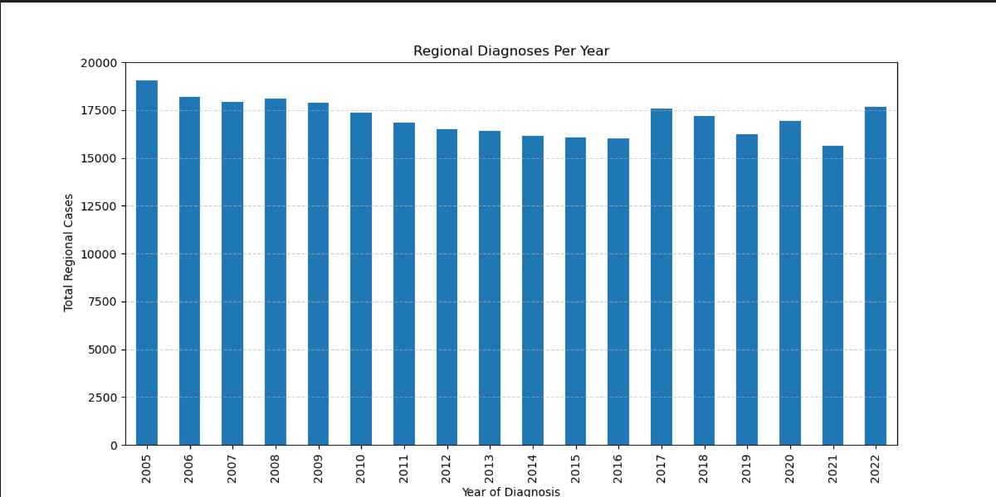
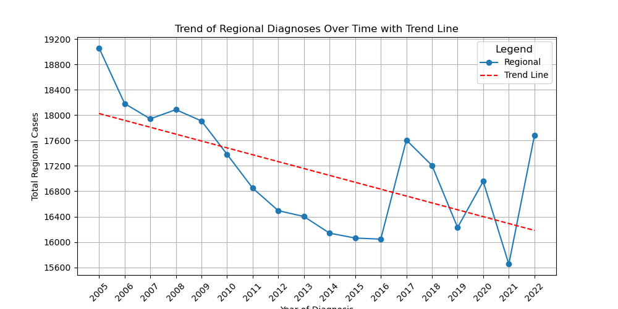
Cancer Rates by Year: What year has the most cancer cases?
This bar graph shows an overall stable trend, with very mild fluctuations of cancer cases from 2010-2017
A notable spike occurs from 2016 to 2017 and again from 2021 to 2022
From 2008 to 2016 a trend of decreasing diagnosis is seen in the bar graph
With ~17500 cases in 2008 to a little over 15,000 cases in 2016 (~2,500 decreases)
This scatter plot graph with a trend line showcases a more granular view of the data. Highlighting a significant drop of cancer diagnosis from 2005 to 2021 with a spike in 2022
Spike goes from ~15,600 in 2021 cases to a little over 17,600 in 2022 ( ~2,000 increase)
Lowest diagnosis rate of 16,000 cases was in 2016 with another spike in 2017 to 17,600 cases- 1,600 increase
Notes:
Krishna

Slide 5

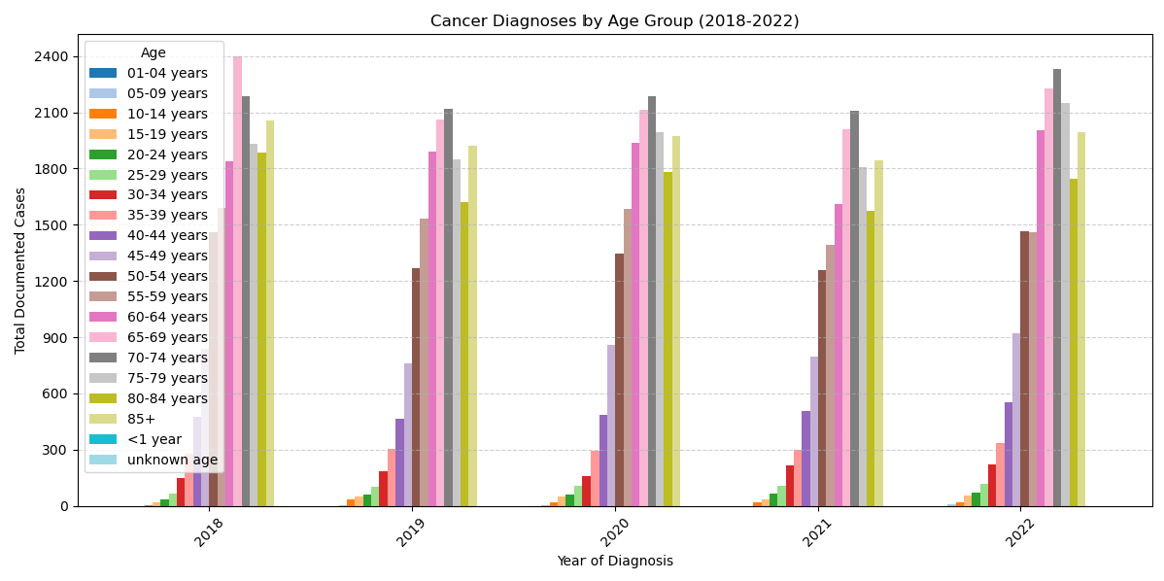
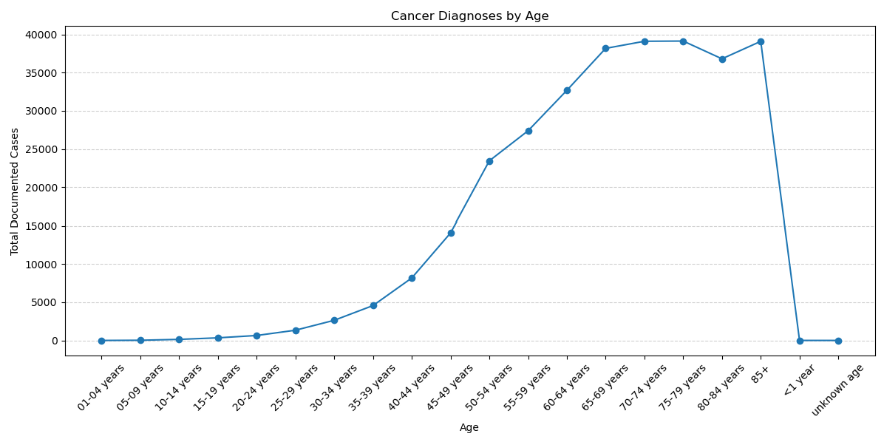
Cancer Rates by Age: What age is cancer most prevalent?
Focusing on the last 5 years of the data set we can see that the peak age where cancer diagnosis is most prevalent is at the ages of 70-74
However, in 2018 there is a significant spike for those in the age bracket of 65-69 years, with a total of 2,400 documented cases
Overall, each age bracket maintains the same trend with minimal fluctuation in cancer cases over the last 5 years
In this graph we can see a constant uphill slope of increased cancer cases with age
The number of cancer cases rises significantly reaching the highest point around the 65-75 age bracket
There is a slight decline of cancer cases in the 85+ age group from ~40000 to ~35000
We can also see that cancer cases begin to rise beginning at the age of 35-39 years of age at ~1000 cases and steadily increasing from there
Notes:
Haby

Slide 6
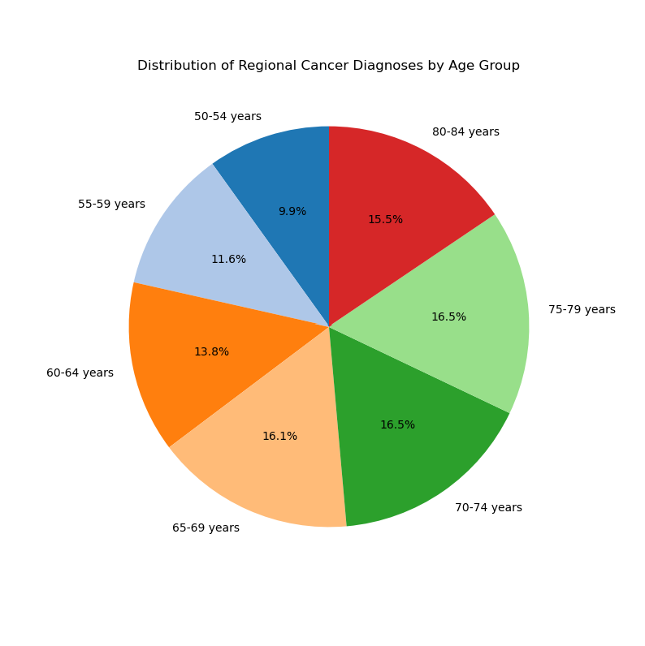
Cancer Rates by Age: What age is cancer most prevalent?
Highest prevalence in cancer diagnosis by % are between the ages 70-79
Age bracket 70-74 & 75-79 both make up a 16.5% of cancer diagnosis
However, age bracket 65-69 makes up 16.1% of cancer diagnosis, just a .3% difference from the 70-79 age bracket.
Margin is so small that it extends the age range to 65-79 having the highest prevalence of cancer diagnosis
Notes:
Haby

Slide 7

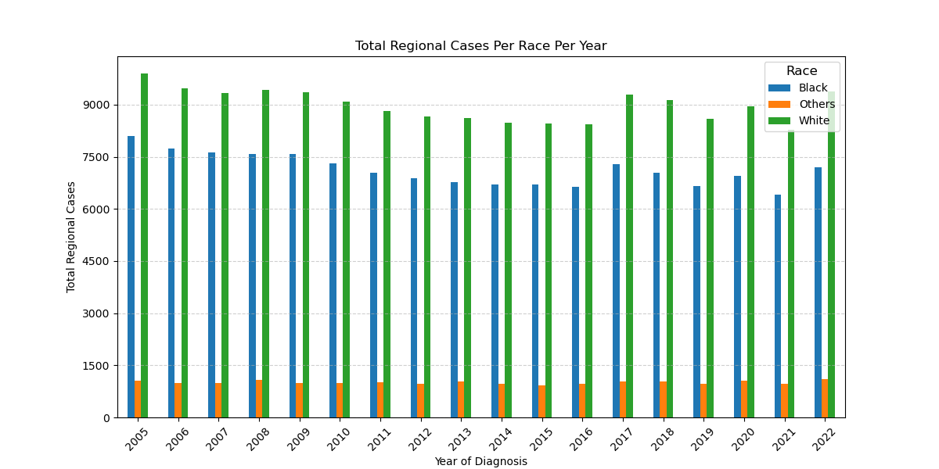
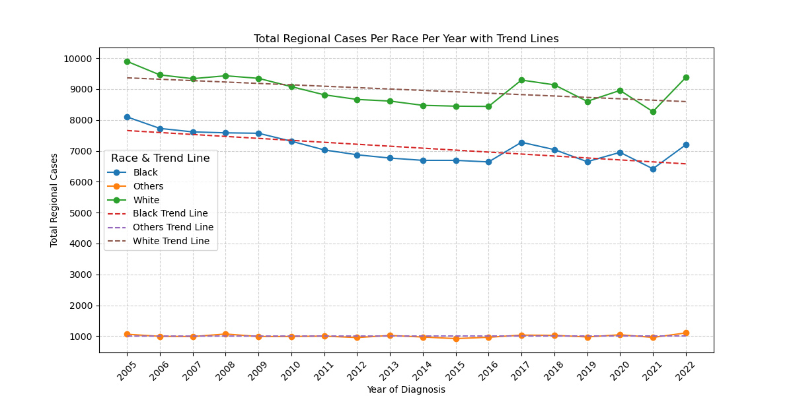
Cancer Rates by Race: What race is most affected by cancer?
This bar graph significantly highlights that White individuals have the highest number of diagnosed cases consistently across all the years, followed by Black individuals and Other racial groups
Cancer rates per race are highlighted as such:
White individuals, >8000 cases from 2005-2022
Black individuals, 6500<~7500 cases from 2005-2022
Other races <~1000 cases from 2005-2022
White and black individuals have a mirroring trend line- both races have a trend drop in 2016 with a slight spike in 2017 and both groups have a drop in 2021 with a spike in 2022.
White individuals' cancer cases do not go below 8,000 cases while Black individual cancer cases do not go above 8,000
Other racial group trend remains consistently low throughout the years, with <1000 cases over every year
Other has the lowest colorectal cancer diagnosis compared to the other racial groups
Notes:
Monica

Slide 8

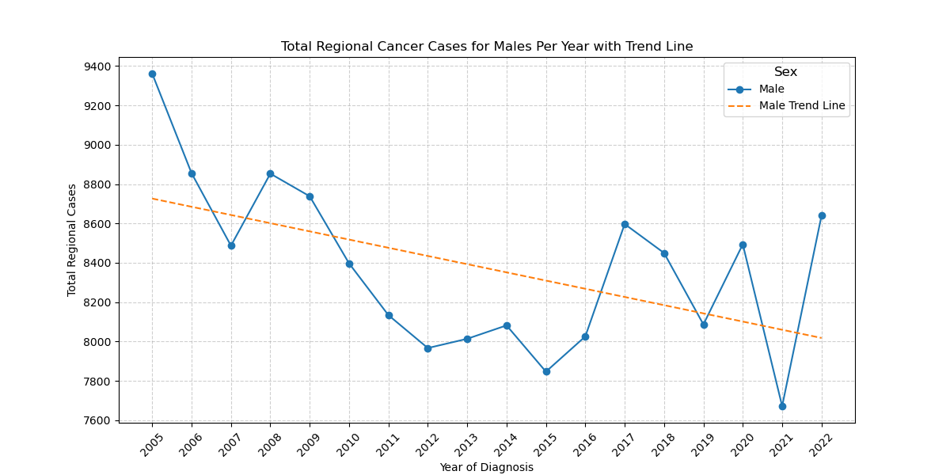
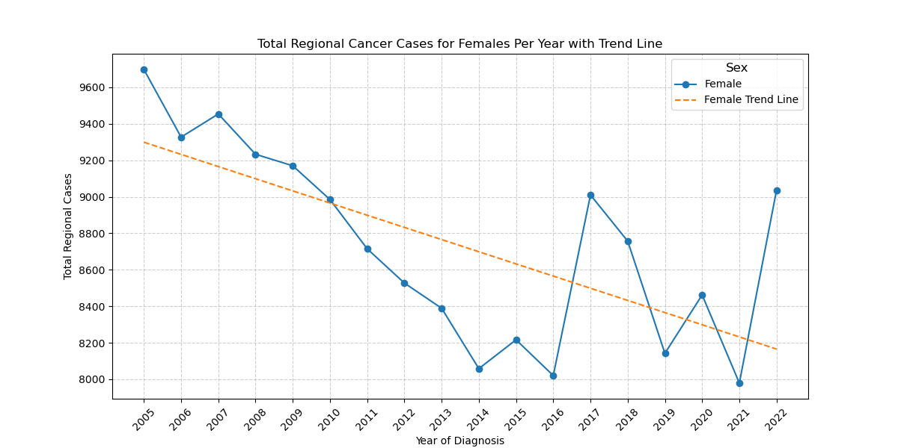
Cancer Rates by Sex: What sex has an increased risk for cancer?
Cancer cases for men show an overall declining trend line- however multiple notable spikes are recorded in:
2007-2008 an increase of ~300 cases
2016-2017 an increase of ~600 cases
2021-2022 an increase of ~1,000 cases
With ~9,400 cases in 2005 to ~8,600 cases in 2021 there is a difference of ~800 cases
AVG cases per year ~8,414
Similar to the trend line we see in the men’s data- the cancer cases for women also have an overall declining trend with notable spikes seen in:
2016-2017 an increase of 1,000 cases
2021-2022 an increase of 1,000 cases
*2017-2019 a decrease of ~1,000 cases
With over 9,600 cases in 2005 to ~9,000 cases in 2021 there is a difference of ~600 cases
AVG cases per year ~8,634
Notes:
Jennifer

Slide 9
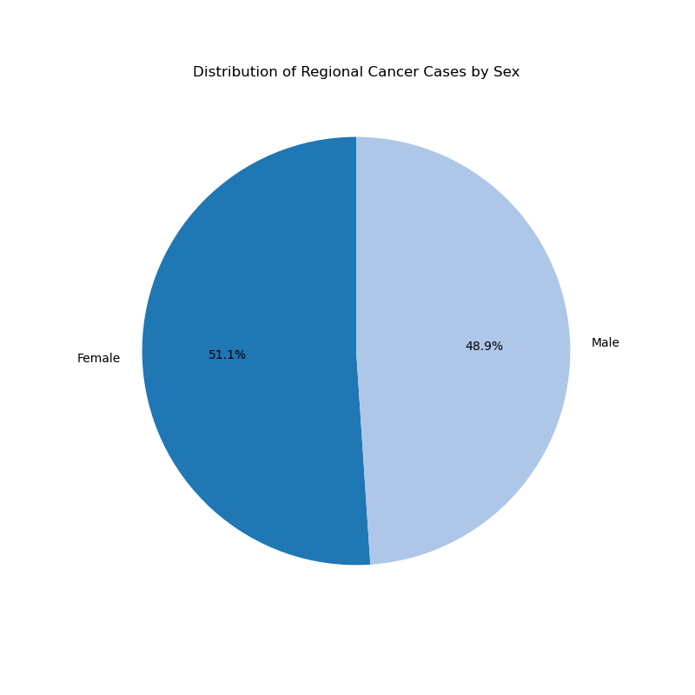
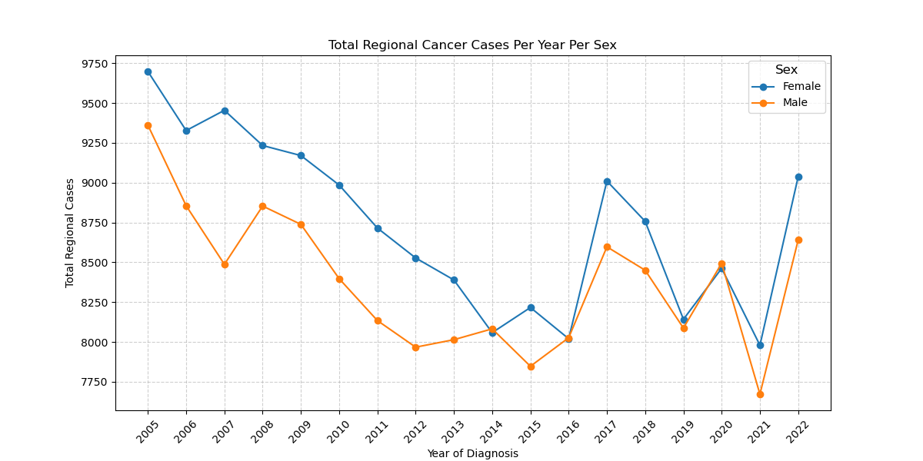
Cancer Rates by Sex: What sex has an increased risk for cancer?
Females have a slightly higher risk of cancer with a 2.2% higher chance of being diagnosed with colon cancer, making up 51.1% of cases compared to men that make up 48.9% of cases
Females have a slightly higher risk of cancer with a 2.2% higher chance of being diagnosed with colon cancer, making up 51.1% of cases compared to men that make up 48.9% of cases
Notes:
Jennifer

Slide 10

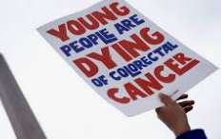

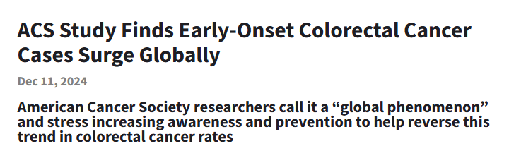


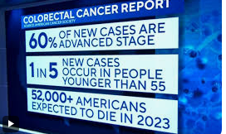
FINDINGS & INSIGHTS
Recap
Hypothesis: Colon Cancer (excluding rectum) diagnosis rates have increased in the US over the years despite the continual advancement of modern medicine.
We believed that cancer diagnosis where on the rise in Millennials and Gen Z given current news and trends
Factors that we thought increased cancer risks in Millennials and Gen Z include- processed food, lack of fiber, food trends such as Carnivore Diet & Tofu Diet, increased energy drinks, diet soda drinks and food ingredients
Findings
Due to the spike of colon cancer from 2021 -2022 our hypothesis is true, colon cancer is on the rise.
Regardless of the downward trend, that spike from 2021 has alarmed many generations such as Gen Z and Millennials which is why we see the media advocating for Colon Cancer awareness
Notes:
Jennifer

